Slide 1



MILESTONE PROJECT
SALARY DATA ANALYSIS
SWETHA S
DADS-August
Cohort B

Slide 2

PROJECT OVERVIEW & OBJECTIVES
Analyze salary patterns across industries, genders and
education levels.
Use SQL for querying and Excel for visualization.
Present insights from a salary dataset.
.

Slide 3
DATASET DESCRIPTION
The Dataset consists of 27774 rows and 17 columns
Age Range, Gender, Education, Industry, Job Title, Country, City, Annual Salary, Additional Compensation, Years of Experience (Overall & In Field)

Slide 4
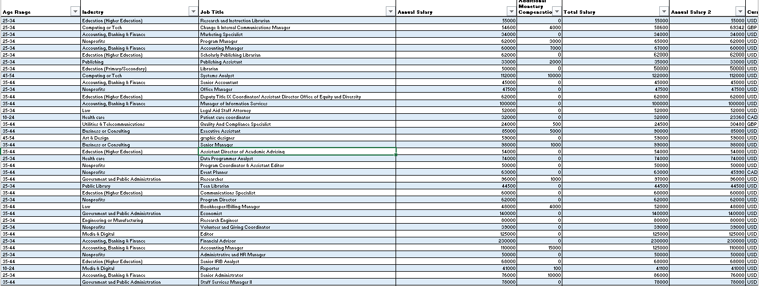
DATA CLEANING & PREPARATION
Removed null and duplicate values.
Standardized categorical data (e.g., job titles, education).
Converted salary to numeric values (USD).
.

Slide 5

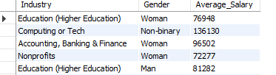
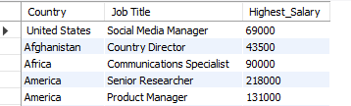
SQL DATABASE CREATION
Average salary by industry & gender
Total compensation by job title
Salary vs. education level
Employees by industry & experience
Median salary by age & gender
Highest salary by country
Salary by city & industry
Compensation trends by gender
Total comp by job & experience
Salary by industry, gender & education

Slide 6
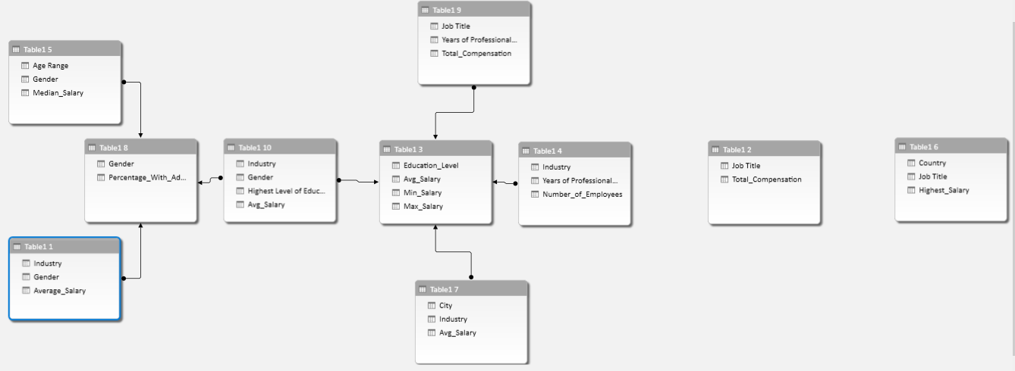
RELATIONSHIP CONNECTIVITY FOR DIFFERENT DATA’s

Slide 7
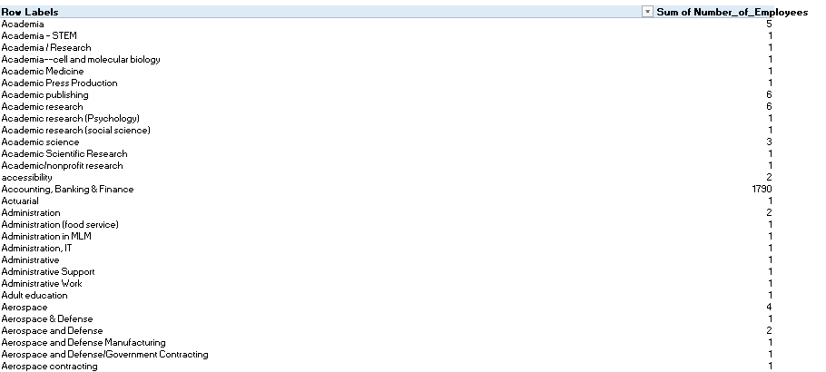
PIVOT TABLES AND CHARTS
• Pivot Table summarizes salary data by Industry, Gender, and
Education Level.
• Pivot Charts visualize salary trends and compensation comparison.

Slide 8

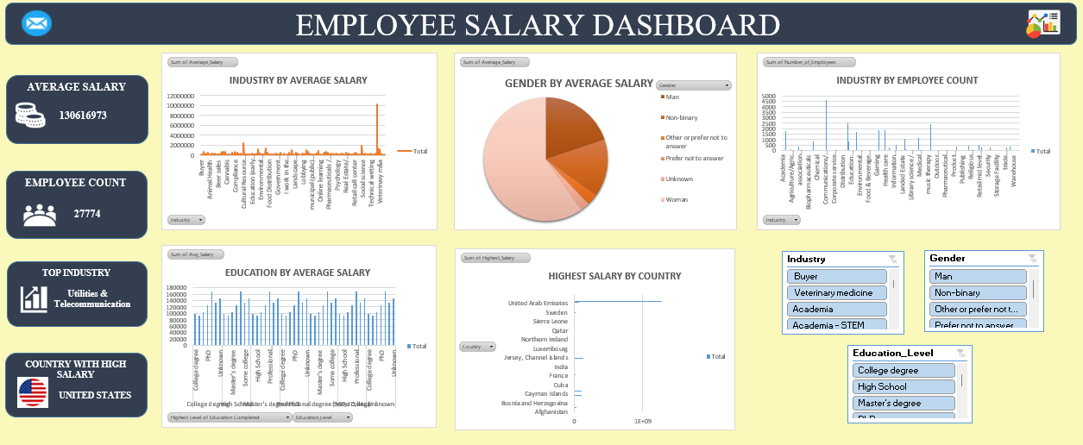
DASHBOARD OVERVIEW

Slide 9


INSIGHTS
• Utilities & Telecommunication sector show the highest average salaries.
• Computing Technology have the high Employee count.
• United States show the top salary figures among listed countries.
• PhD holders show competitive pay levels.

Slide 10
CONCLUSION
The project helped understand global salary trends using Excel and SQL.
Experience, Education, and Industry strongly influence salary levels.
Utilities & Telecommunication are the top-paying sectors overall.
PhD professionals earn the highest averages.
United States shows the highest average salary in the dataset.
The analysis highlights gender differences and industry-based variations in pay.

Slide 11
THANK YOU

